Slide 1
Types of Fraud
And How to Avoid them

Slide 2
Daniel J. Traub
Senior Financial Advisor at Montis Financial. 38 years of experience.
Not an expert in financial fraud. I read quite a bit on the subject, attend seminars, and have helped a number of clients work through fraudulent scenarios.
My Mother is a resident at Orchard Cove, and a recent victim of financial fraud
Daniel Traub
Montis Financial
230 Third Avene
Waltham, MA 02451
781-544-9551
DTraub@MontisFinancial.com

Slide 3
According to the Federal Trade Commission
$12.5 billion was lost to financial fraud in 2024, a 25% increase from 2023. This is only what was reported. Expect actual number to be much higher.
Biggest areas for loss:
Investment scams ($5.7 bn)
Imposter scams ($2.95 bn). The most common
Most common way of contact:
Email
Phone
Text

Slide 4
Check Fraud Occurs when an unauthorized person uses someone else’s checks, or images of a check, to make unauthorized purchases or withdrawals. Use a pen specifically designed for checkwriting/fraud prevention, usually gel.
Consumer Product & Retail Fraud This fraud involves the purchase or sale of goods, often through deceptive marketing or counterfeit products.
Credit Card & Debt Card Fraud Unauthorized use of a person’s credit card or debit card to make purchases or withdrawals.

Slide 5
Debt Collection Fraud Scammers impersonate legitimate debt collectors or creating fake debts to scare victims into paying money they don’t owe. Often use threats of legal action or arrest to force payments.
Elder Financial Exploitation Scammers target older adults by exploiting their trust, vulnerability, or mental state. (Fake charities, grandparent scam, fake lottery, romance scam, medicare/health insurance fraud, caretaker misuse, power of attorney abuse.) An AI voice can actually sound like your grandchild!
Financial and Investment Fraud Trick victims into investing money based on false information and/or promises
Identity Theft Personal financial information, such as Social Security numbers (SSN), bank account details, or credit card numbers are stolen to commit fraud or theft.

Slide 6
Imposter Scam (aka spoofing) Pretend to be someone you trust, such as a government official or a company representative, to steal your money or personal information.
Online and Digital Scams Via the internet, often through deceptive emails, websites, or messages that trick people into providing personal information or money (Fake Website, phishing, fake tech support).
QR Code Scam Restaurant QR codes are probably safe but be wary of QR codes in public. Parking meters are common sources of fake QR codes.

Slide 7
Do
Monitor your credit reports
Obtain free credit reports from AnnualCreditReport.com.
Regularly review your credit reports for any unauthorized inquiries or accounts, suspicious activities, or errors.
Freeze your Credit Reports
Equifax 800-349-9960
Experian 888-397-3742
TransUnion 888-909-8872
Monitor your bank and credit card statement

Slide 8
Do
Use multifactor authentication (especially for cell phone changes!)
Consider a separate credit card for on-line transactions
Call entity back on a number you know to be accurate (not the number they give you or a number on an email)
Use Credit cards
Shred documents with sensitive information
Use pens designed for writing checks
Consider using a PW manager:
1Password
Bitwarden
NordPass

Slide 9
Do
Consider a True Link Pre-paid Visa Card for Seniors with mental limitations (www.truelinkfinancial.com/prepaid-card)
Opt for e-delivery of statements rather than snail mail
Do cell phone updates promptly (security features)
Make sure your current email address (the one you check daily) is listed with all your vendors
Put alerts/restrictions on your financial accounts if you suspect fraud (i.e. Fidelity)
Use “strong” passwords (Louvre!!!)

Slide 10
Don’t
Give your personal financial information to unsolicited sources
Allow anyone remote access to your computer
Buy from vendors until checking them out. Look at ratings, review return policy
Donate to charities before checking them out.
Trust your caller ID. Scammers can make any name or number show up on your caller ID. (See “they won’t call,” below)
Trust email “from” addresses
Use Debit cards
Allow web sites to save your data
Deposit a large “fake” check and send back a smaller real check

Slide 11
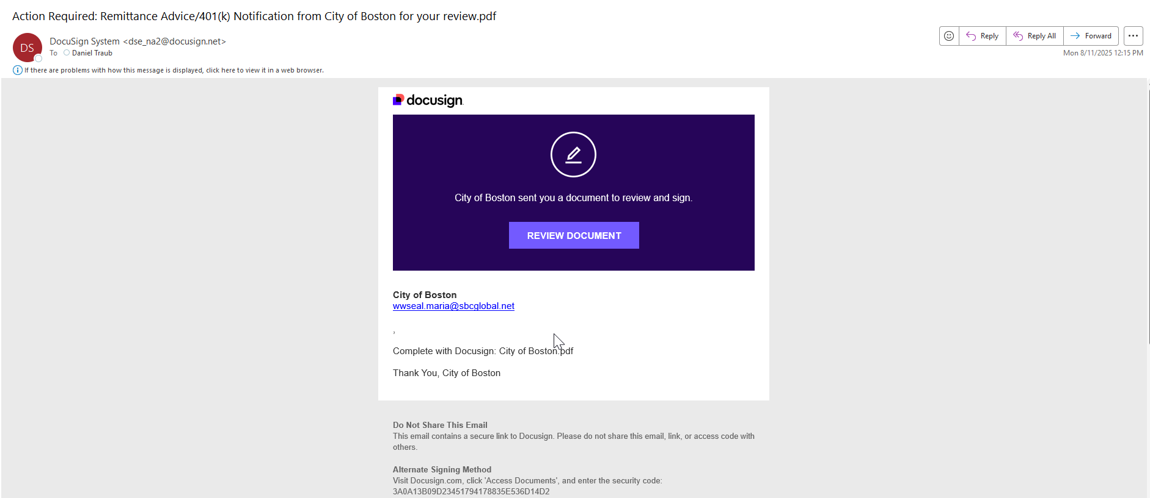
Examples of Pfishing Emails

Slide 12
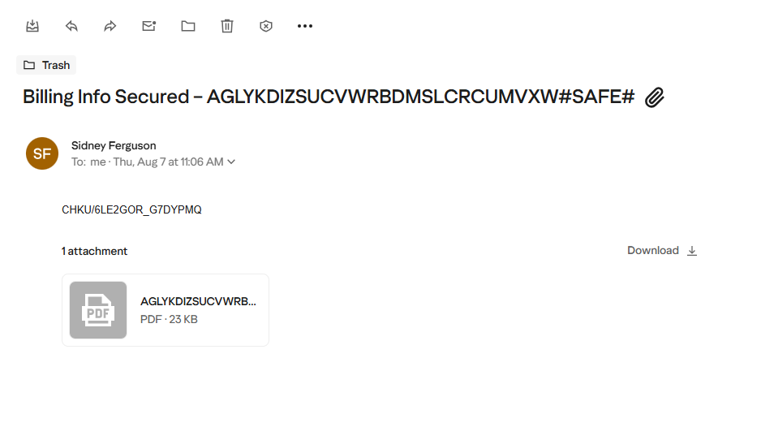

Slide 13
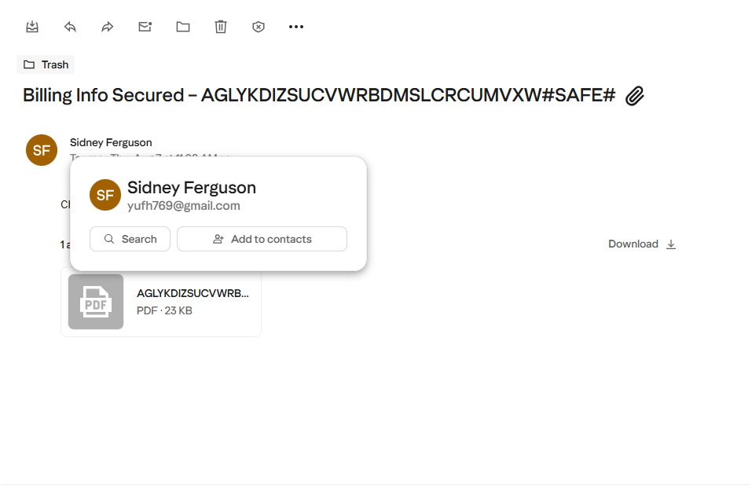

Slide 14
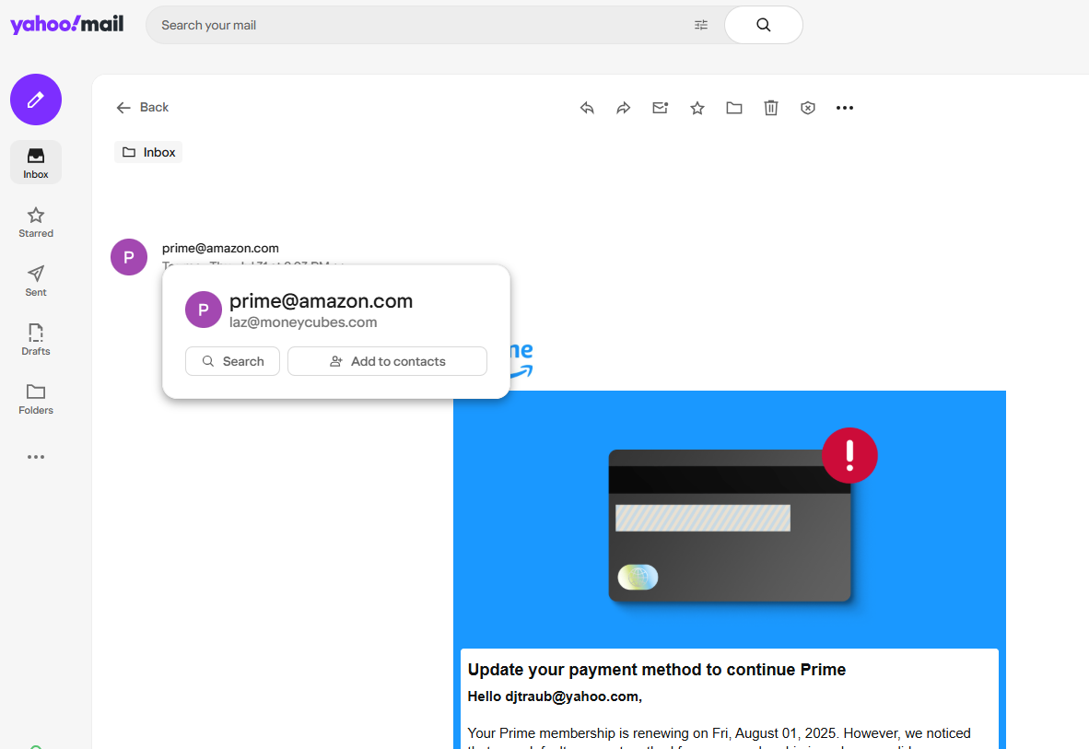
Be wary of suspicious email and don’t click on suspicious links

Slide 15
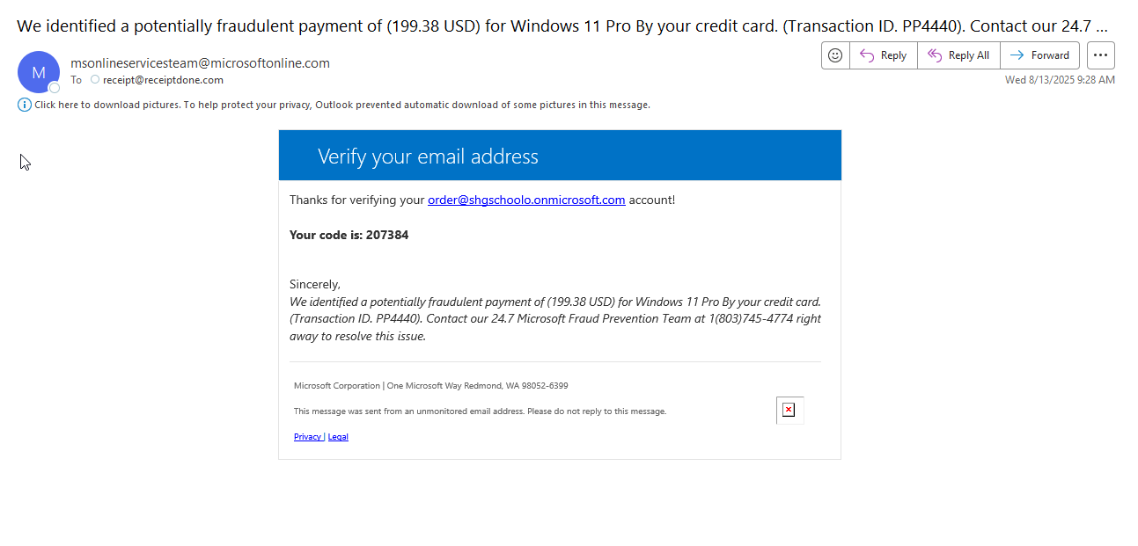

Slide 16
Be Wary of Anyone Who…
Puts pressure on you to act now or else…(arrest, legal action, etc.)
Won’t allow you to hang up
Asks for payment in unusual ways (cash, wires, prepaid cards, gift cards, crypto)
Won’t send you details in writing
Sends a ride to take you to the bank

Slide 17
“They” Will Never Call You!!! Who?
Microsoft
IRS
Tax collectors
Lottery (If you have to pay to get the prize, it is not a prize!)
FBI
Debt relief
Extended car warranties
Free trials (what happens after the free trial?)

Slide 18
What Should You Do?
Hang Up!!!
Block future calls
Ask them to send you something in writing
If you think there is a chance it is legitimate, hang up and contact the company in a way you know to be accurate.

Slide 19
Live by This Motto:
If it seems too good to be true, it is!!!

Slide 20
Resources
National Council on Aging: https://www/ncoa.org/professionals/money/avoiding-scams/
AARP:
www.aarp.org/money/scams-fraud/
877-908-3360 Fraud hotline

Slide 21
Ways To Report
Notify your financial institution. Dispute any unauthorized charges
File a report with local law enforcement (i.e. Canton Police)
Report to the Internet Complaint Center (ic3.gov)
Report to Federal Trade Commission (FTC) (IdentityTheft.gov) or 1-877-438-4338
For mail related scams contact The U.S. Inspection Service (uspis.gov or 1-877-876-2455

