Slide 1
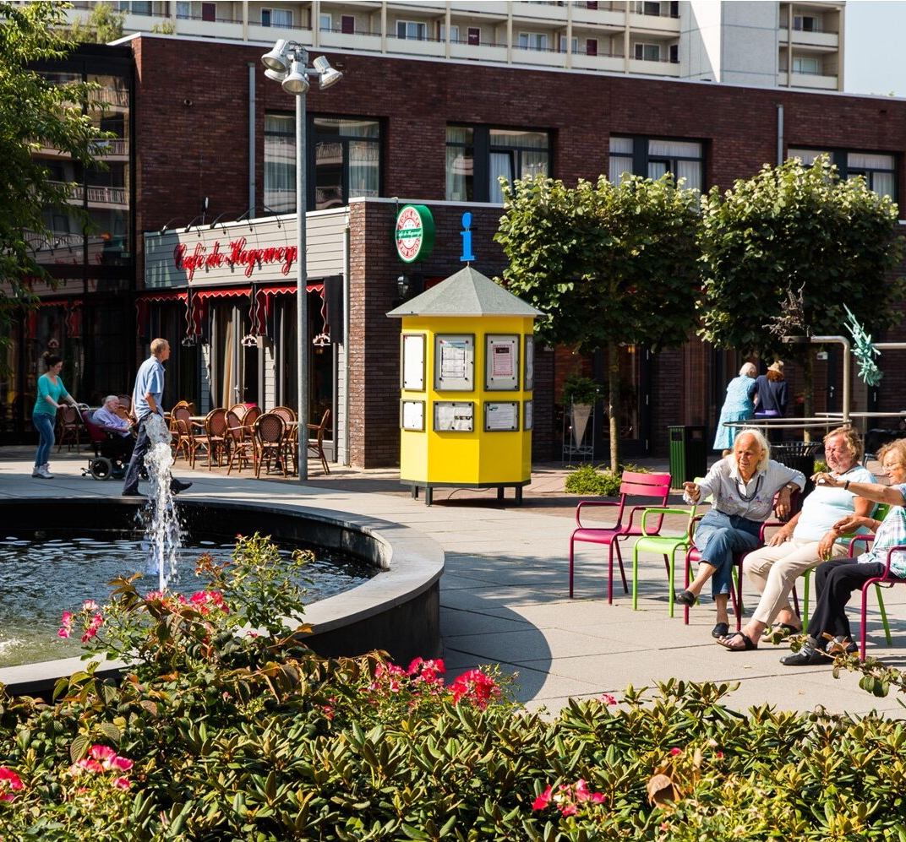
What We Can Learn from The Hogeweyk A Social Dementia Care Model
Rethinking Dementia: Community, Dignity, and Design

Slide 2
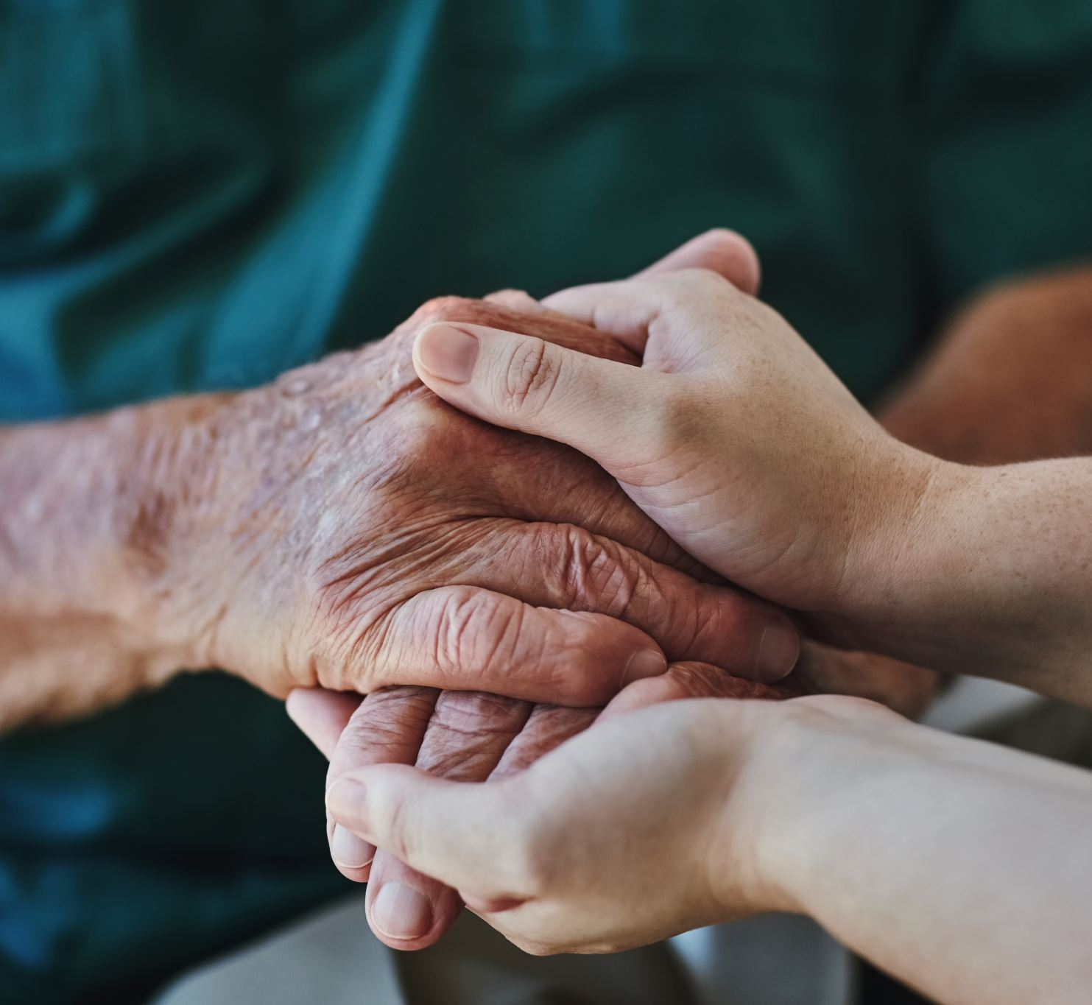
Why this Matters
Growing dementia population in the U.S.
Currently over 7 million Americas living with Alzheimer’s
1 in 3 older adults dies with Alzheimer’s or another dementia
The US is seeing the largest population of elderly individuals in our history
Need for more humane, person-centered care

Slide 3
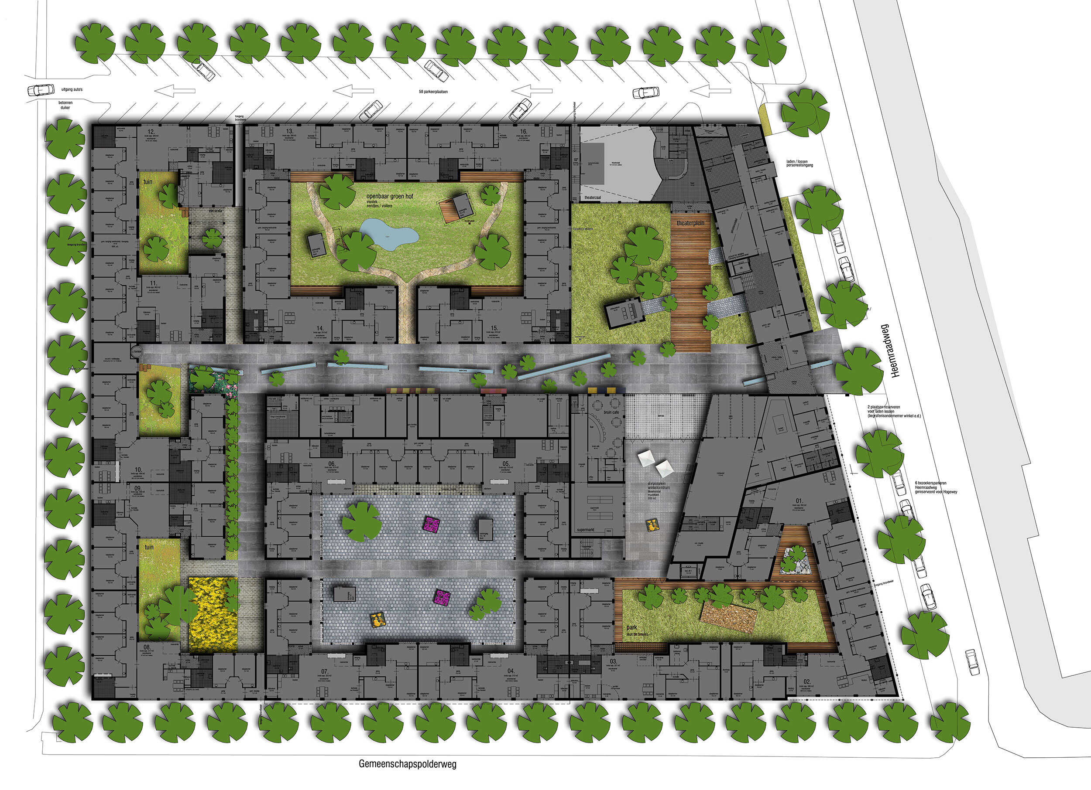
The Hogeweyk
Located in the Netherlands; founded 2009
Dementia village designed to resemble real life
24/7 care in a community setting
188 Residents

Slide 4
The Hogeweyk’s 7 Pillars
Favorable Surrounding
Lifestyle
Health
Life’s Pleasures & Meaning of Life
Formal & Informal Network
Organization
Social Inclusion & Emancipation

Slide 5
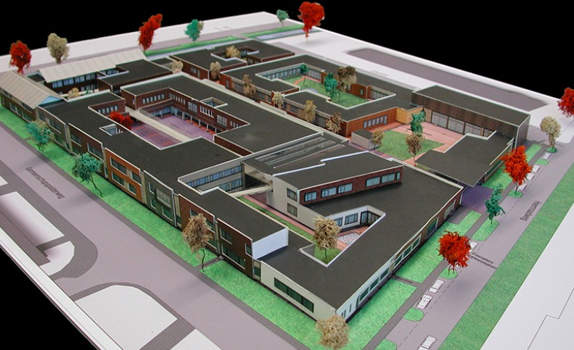

Slide 6
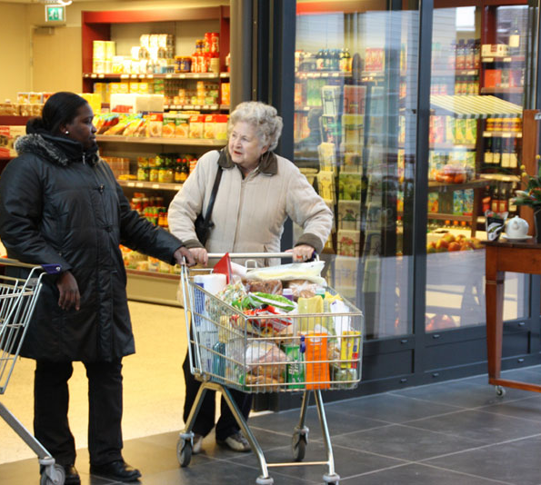
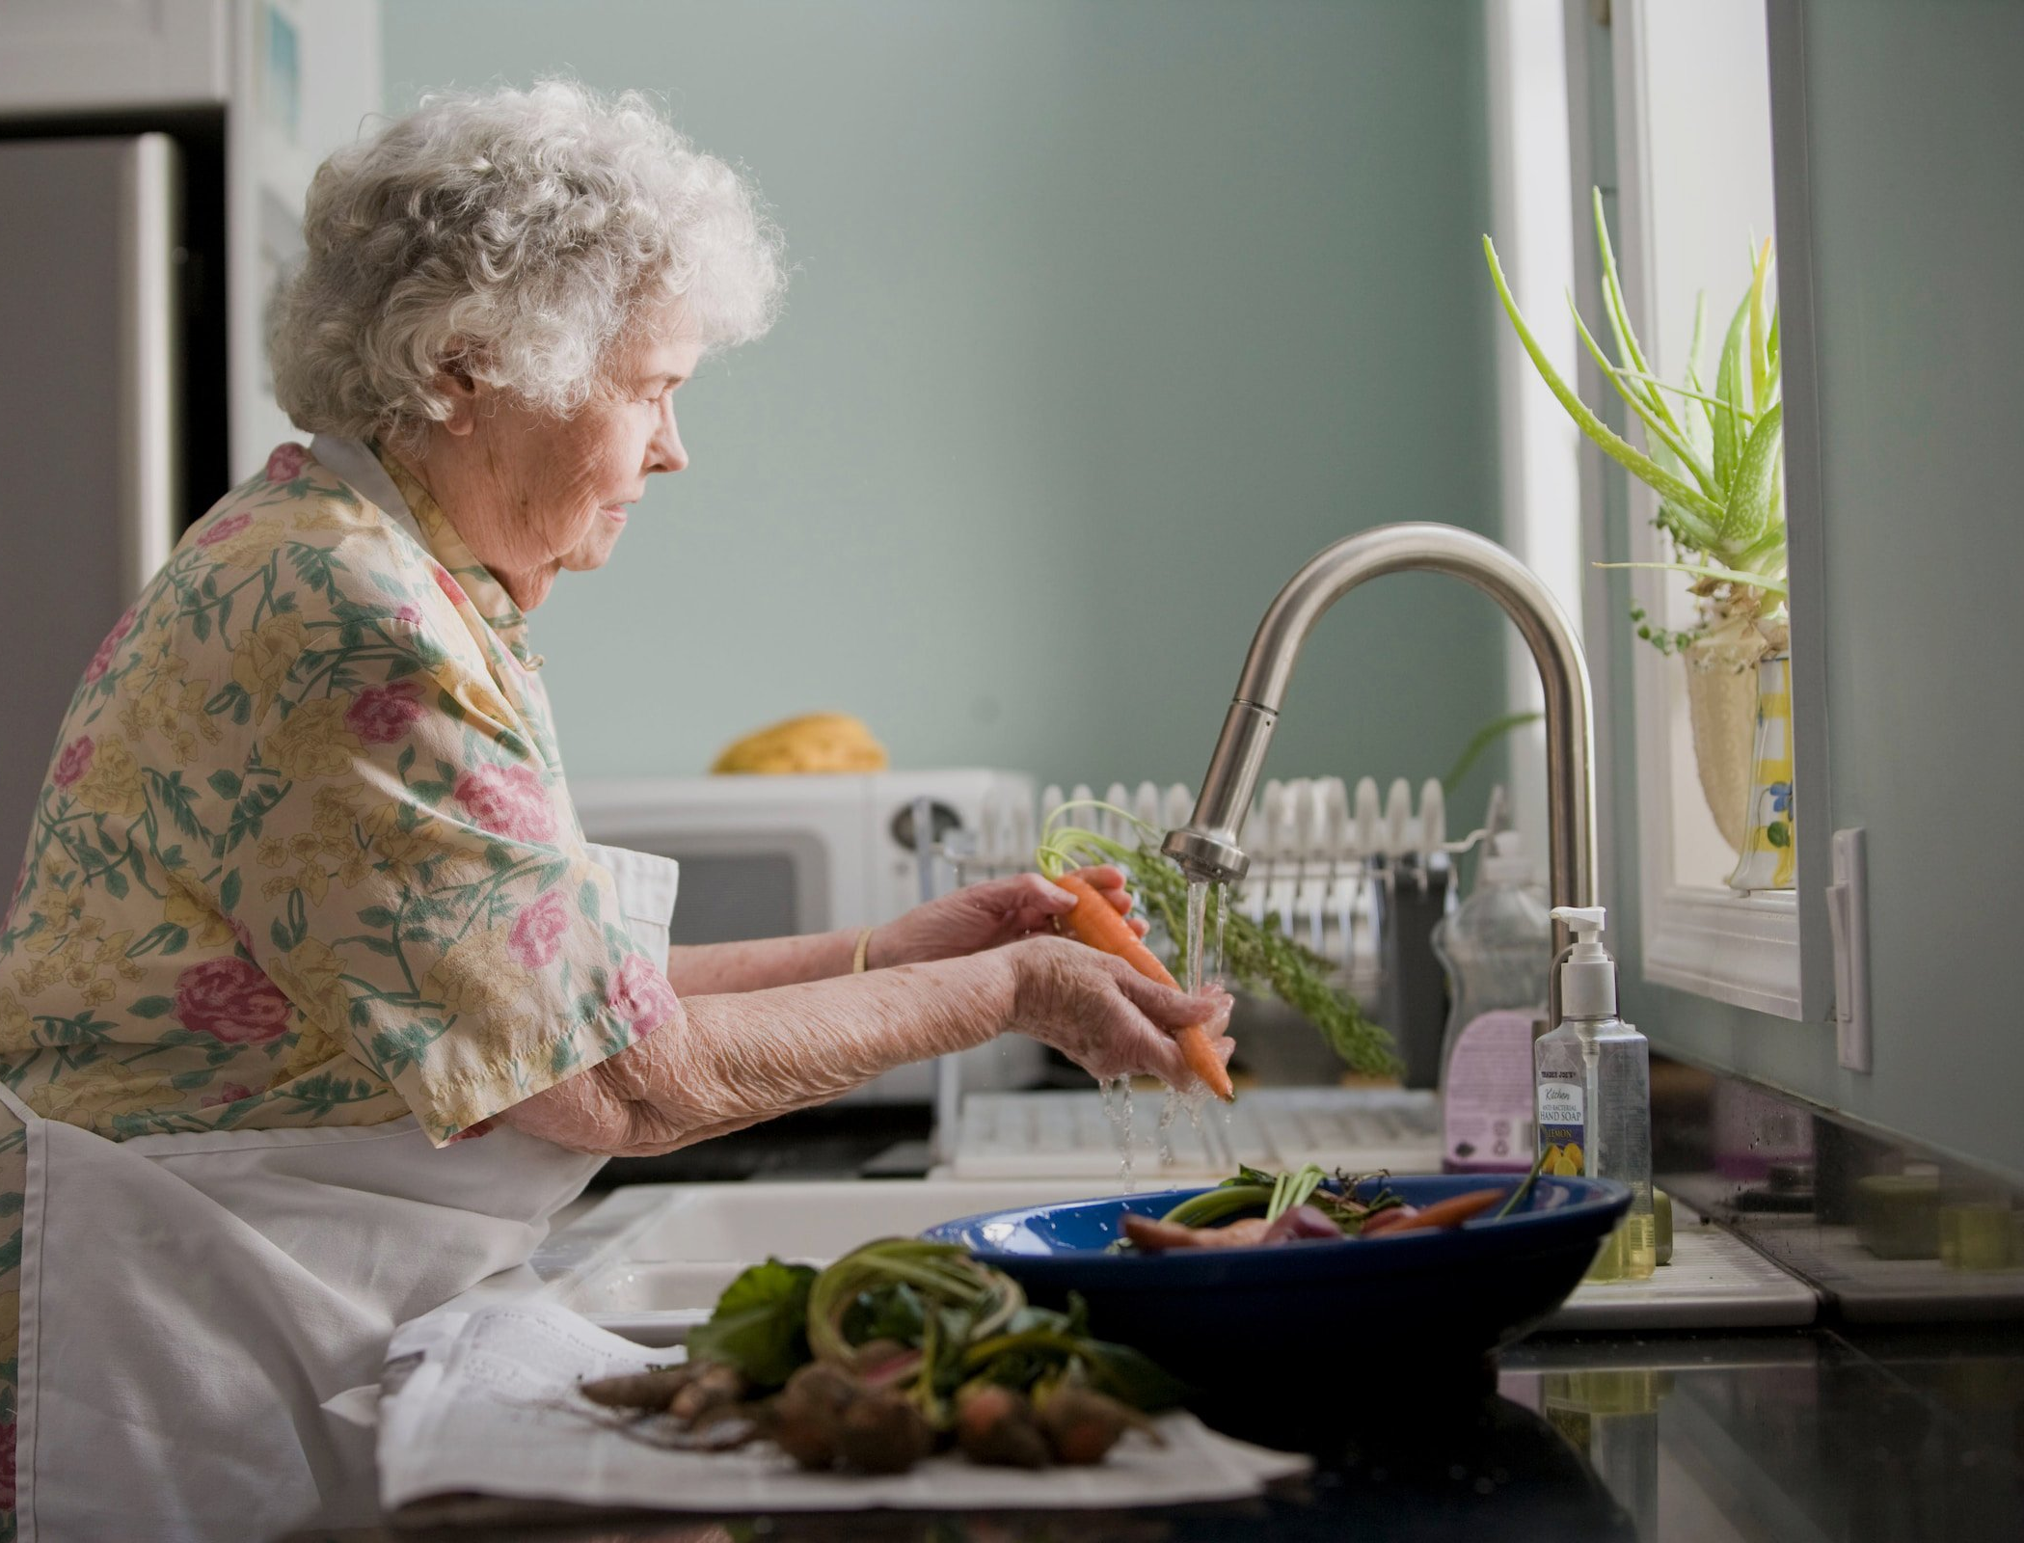
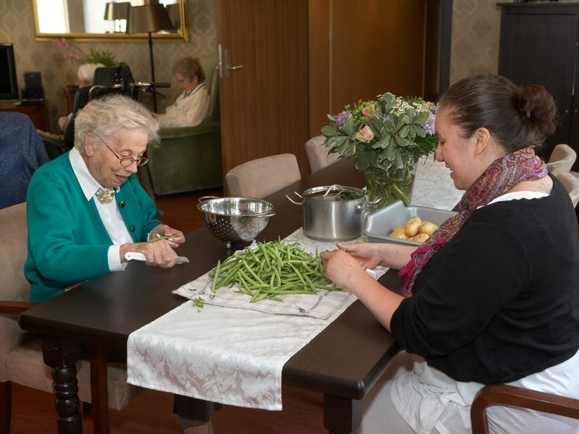
Core Principles of The Hogeweyk
Dignity and autonomy
Normalcy and freedom of movement
Lifestyle-based households
Purposeful daily routines

Slide 7
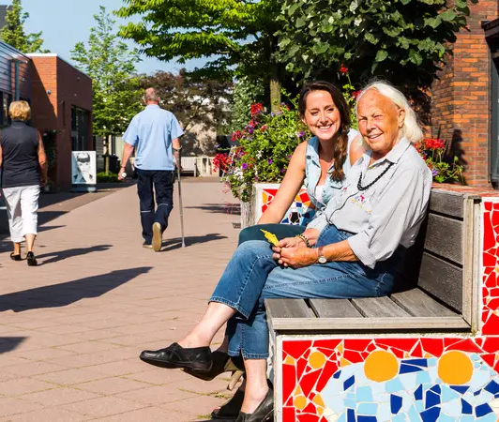
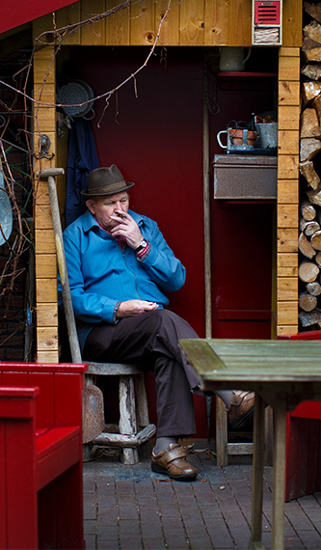
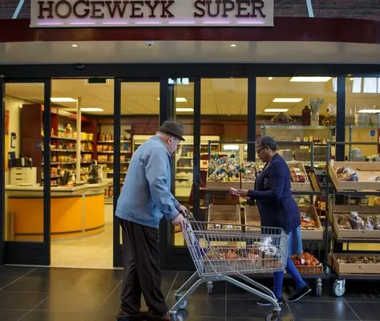
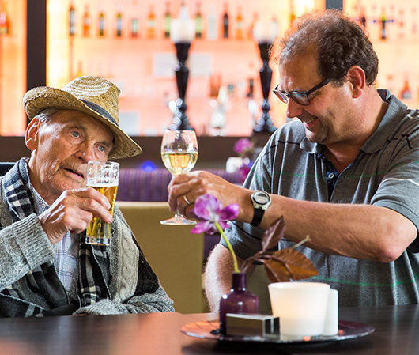
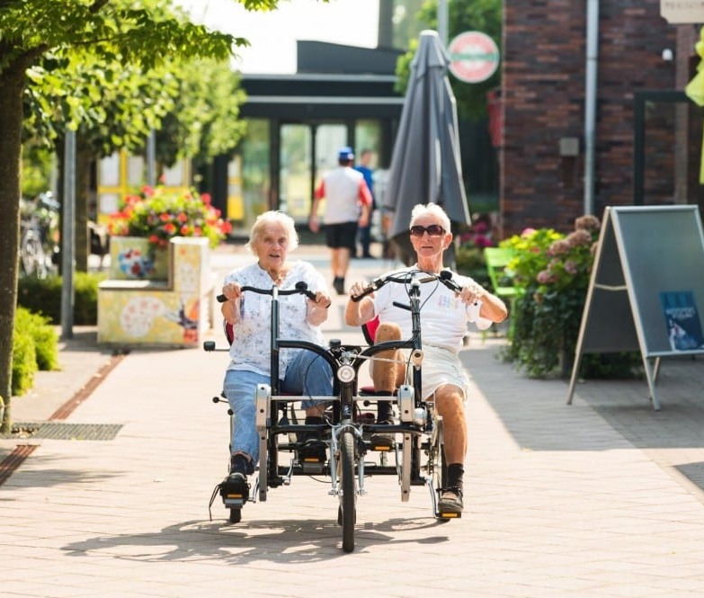

Slide 8
U.S. Dementia Care: A Comparison
The United States
Traditional Nursing Homes
More Institutional/Clinical Setting
Risk-Adverse Environment
The Hogeweyk
Home-Like Setting focused on Everyday Life
Autonomy-Supportive Model
Focus on Choice
Neighborhood/Normal Lifestyle
Focus on Liability/Potential for Harm

Slide 9

Legal & Ethical Dimensions
Autonomy
Supported Decision Making
Resident Rights
Safety
Guardianship/ Conservatorship
Dignity

Slide 10
U.S. Regulatory Concerns
Zoning and licensing barriers
CMS and state long-term care standards
HIPAA compliance in open environments

Slide 11
Risk & Liability
Elopement and injury concerns
Informed consent and legal waivers
Mitigating risks while preserving autonomy

Slide 12
Funding & Accessibility
Cost comparisons with U.S. long-term care
Medicaid and HCBS waivers
Equity: ensuring access beyond the affluent

Slide 13
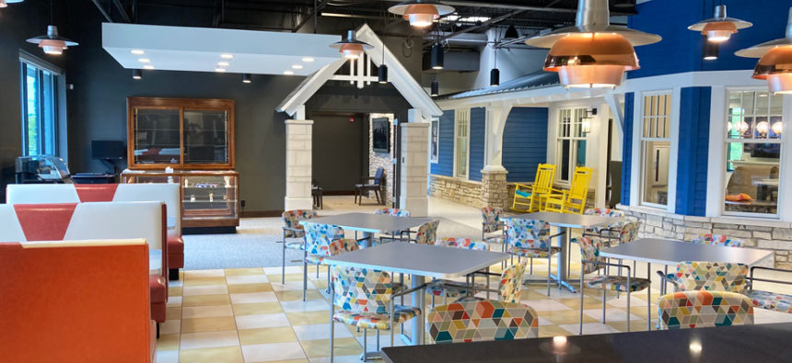
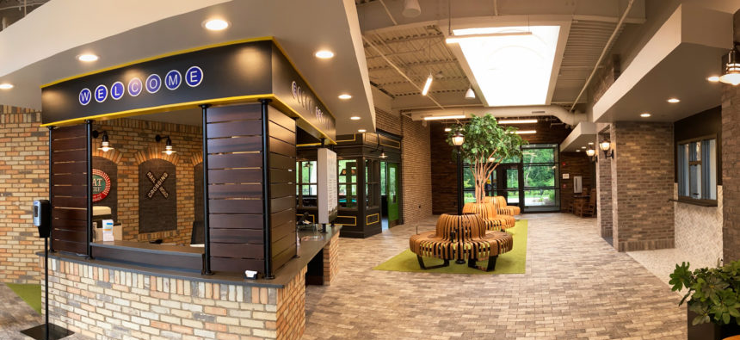
Real Life Innovations in U.S.
Milton Adult Day Services, South Bend, Indiana
The environment provides a home and town-like setting where individuals have more regulated independence and less institutional style programming.

Slide 14

Real Life Innovations in U.S.
Livasu (Living as Usual) Village, Sheboygan, Wisconsin
A nonprofit-led project aiming to create a scaled-down dementia village (124 homes on donated land) that incorporates Hogeweyk’s ethos—community integration, natural elements, and incremental design improvements—to lower costs and initiate change slowly.
Currently under construction
STAY TUNED

Slide 15
What’s One Small Step We Can Take?
What legal changes would be needed to implement a Hogeweyk-style model here?
What operational and cultural shifts are needed to implement a Hogeweyk-style model here?
How can we support more dignity-centered care?

