Slide 1
What’s All This AI Hype About?
Simple Ways AI Can Actually Help—Including Uses You Might Not Expect

Slide 2
Using AI
You don’t need to be tech-savvy (If you can type, you can use this)
You can’t break anything
Around 91% accurate
(depends on user)
Notes:
91% is obviously not 100%. SO double check things, but just know. That 91% is often because of user error. And we’ll cover that

Slide 3
What is AI?
Love it or hate it, it’s not going away.
In fact, it’s getting much harder to avoid it
Why learn about AI
Notes:
Google is using it, websites. Phone number, commercials. You are on the internet now. Zoom even.

Slide 4
What is AI?
“Its like having the smartest people from every industry at your fingertips, 24/7”
LLM
(an apple a day…)
Notes:
It also predicts what you may want to know about next. Is it true. Want to hear about the history of the say?

Slide 5
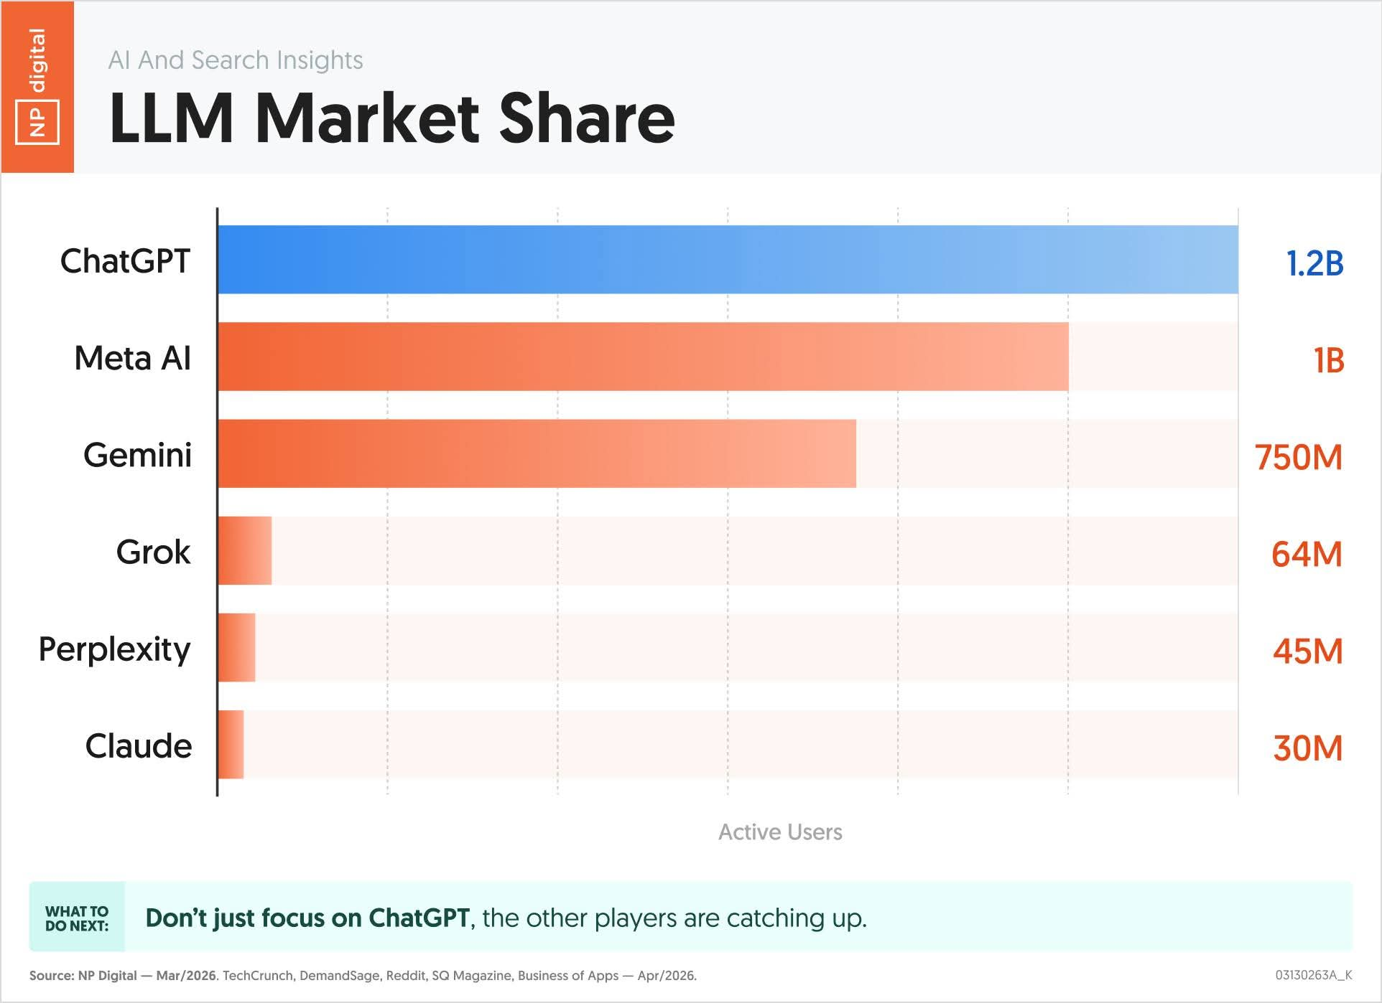
AI Software
ChatGPT
Meta AI
Google Gemini
Grok
Perplexity
Claude
Notes:
4 billion users. Largest growth in history. I may use chatgpt and AI interchangeable.

Slide 6
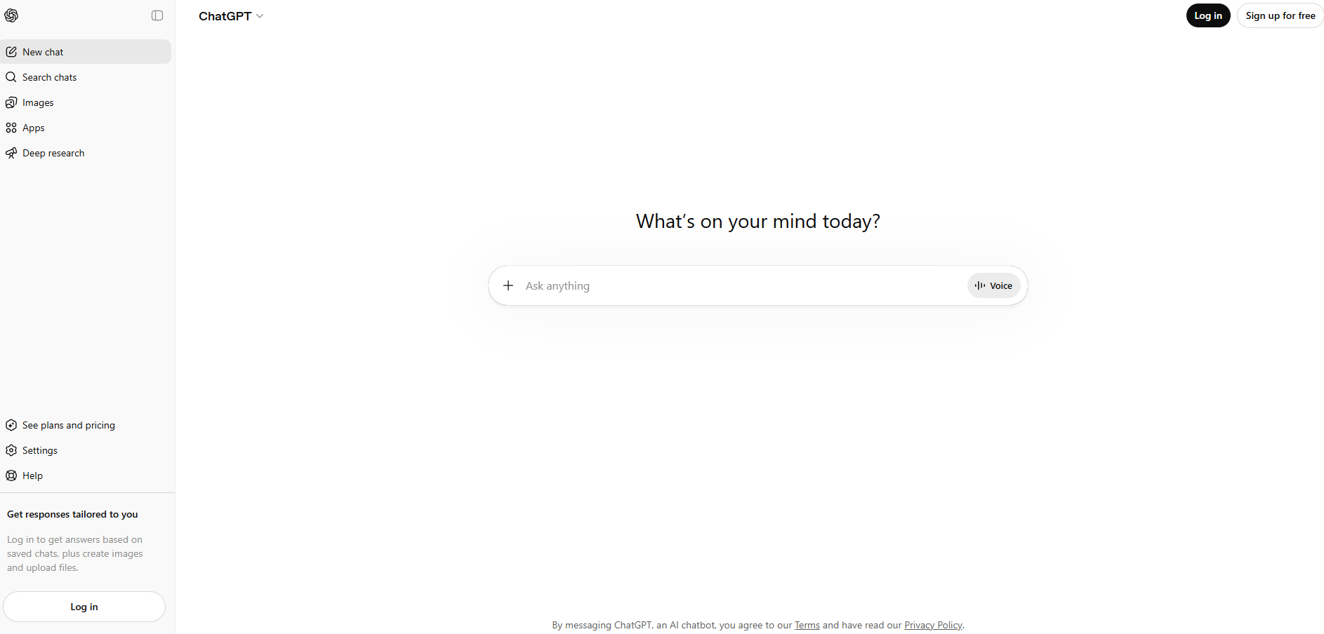
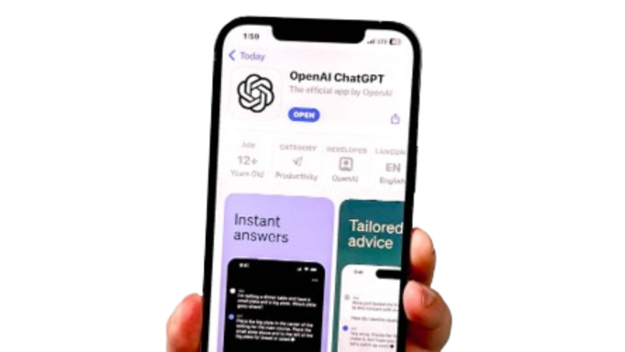
AI Software
ChatGPT.com

Slide 7
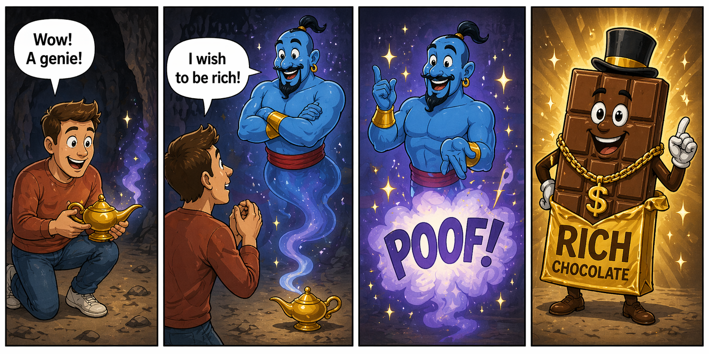
How to Talk to AI
The Genie
Notes:
How you talk to it is important. You get bad results when you ask bad questions.

Slide 8
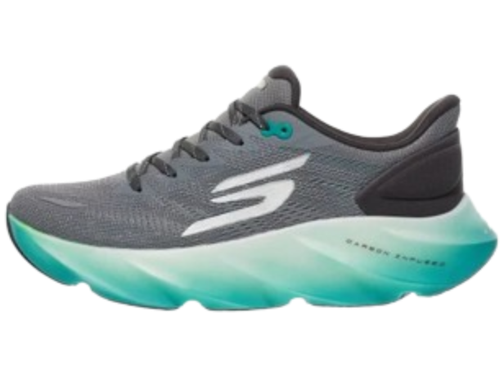
How to Talk to AI
My lower back hurts when I stand for too long. What should I do?
Get cushioned shoes
Arch support
Anti-fatigue mat
Etc.
This is how most people us AI.
And this is why people think AI is useless.
Notes:
Real life examples

Slide 9
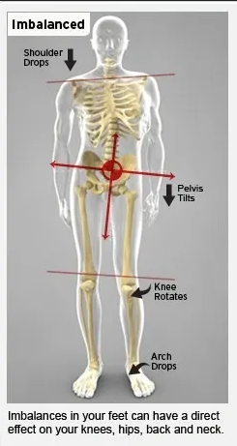
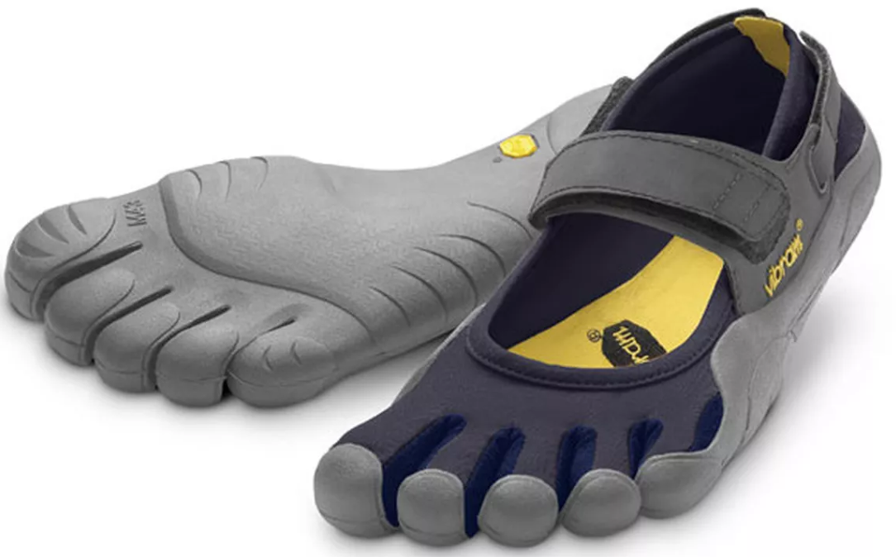
How to Talk to AI
My lower back hurts when I stand barefoot on hard floors, but it feels better when I wear shoes especially my Nike Metcon shoes. I exercise and strengthen those muscles but it still hurts. What might be causing that?
Weak feet
Foot flexibility
Foot Strengthening
Barefoot shoes
Refered to previous “chats”
Notes:
This opened a rabbit hole of research.

Slide 10
How to Talk to AI
My car is broken down on the side of the interstate, what should I do?
I have a 2007 Toyota Prius C7. I was drive at 65 mph and and I got battery and engine lights. I could not accelerate anymore. I pulled over. Put it in park. Now I can’t get it into drive.
Notes:
Tell story of highway fix

Slide 11
How to Talk to AI
(on the flip side)
AI can be a “Tell me what I want to hear machine”
I received this email yesterday. It seems a little suspicious, and I think it might be a scam. Take a look at the email address—it looks unusual. There are also several misspellings and grammar issues. Plus, how would a Nigerian prince even get my email address? What do you think?
Notes:
Confirmation bias

Slide 12
How to Talk to AI
Is this email a scam?
I don’t know the person who sent it.
Appeared in my personal email today.

Slide 13
AI Uses
Blood test results
Vitamins
Food recommendation
Recipes
Order food and supplements
Delivered to your house
Notes:
Don’t trust. Not a doctor, etc.
Expand on using it with food.
This is the future

Slide 14
AI Uses
My daughter is turning 17 soon. Give me gift ideas. I want something she’ll actually use. She like hanging out with friends, driving around……
ChaptGPT suggested a 1-year membership to a car wash.

Slide 15
AI Uses
Explain this document to me
Netflix password reset.
Setting up a Wifi.
My Whirlpool XXX dishwasher stops at 44 minutes. It displays 2 dashes on the screen. In order to restart it I have to push the door in till I hear a click, then press start. Why?
Summarize this article for me.

Slide 16
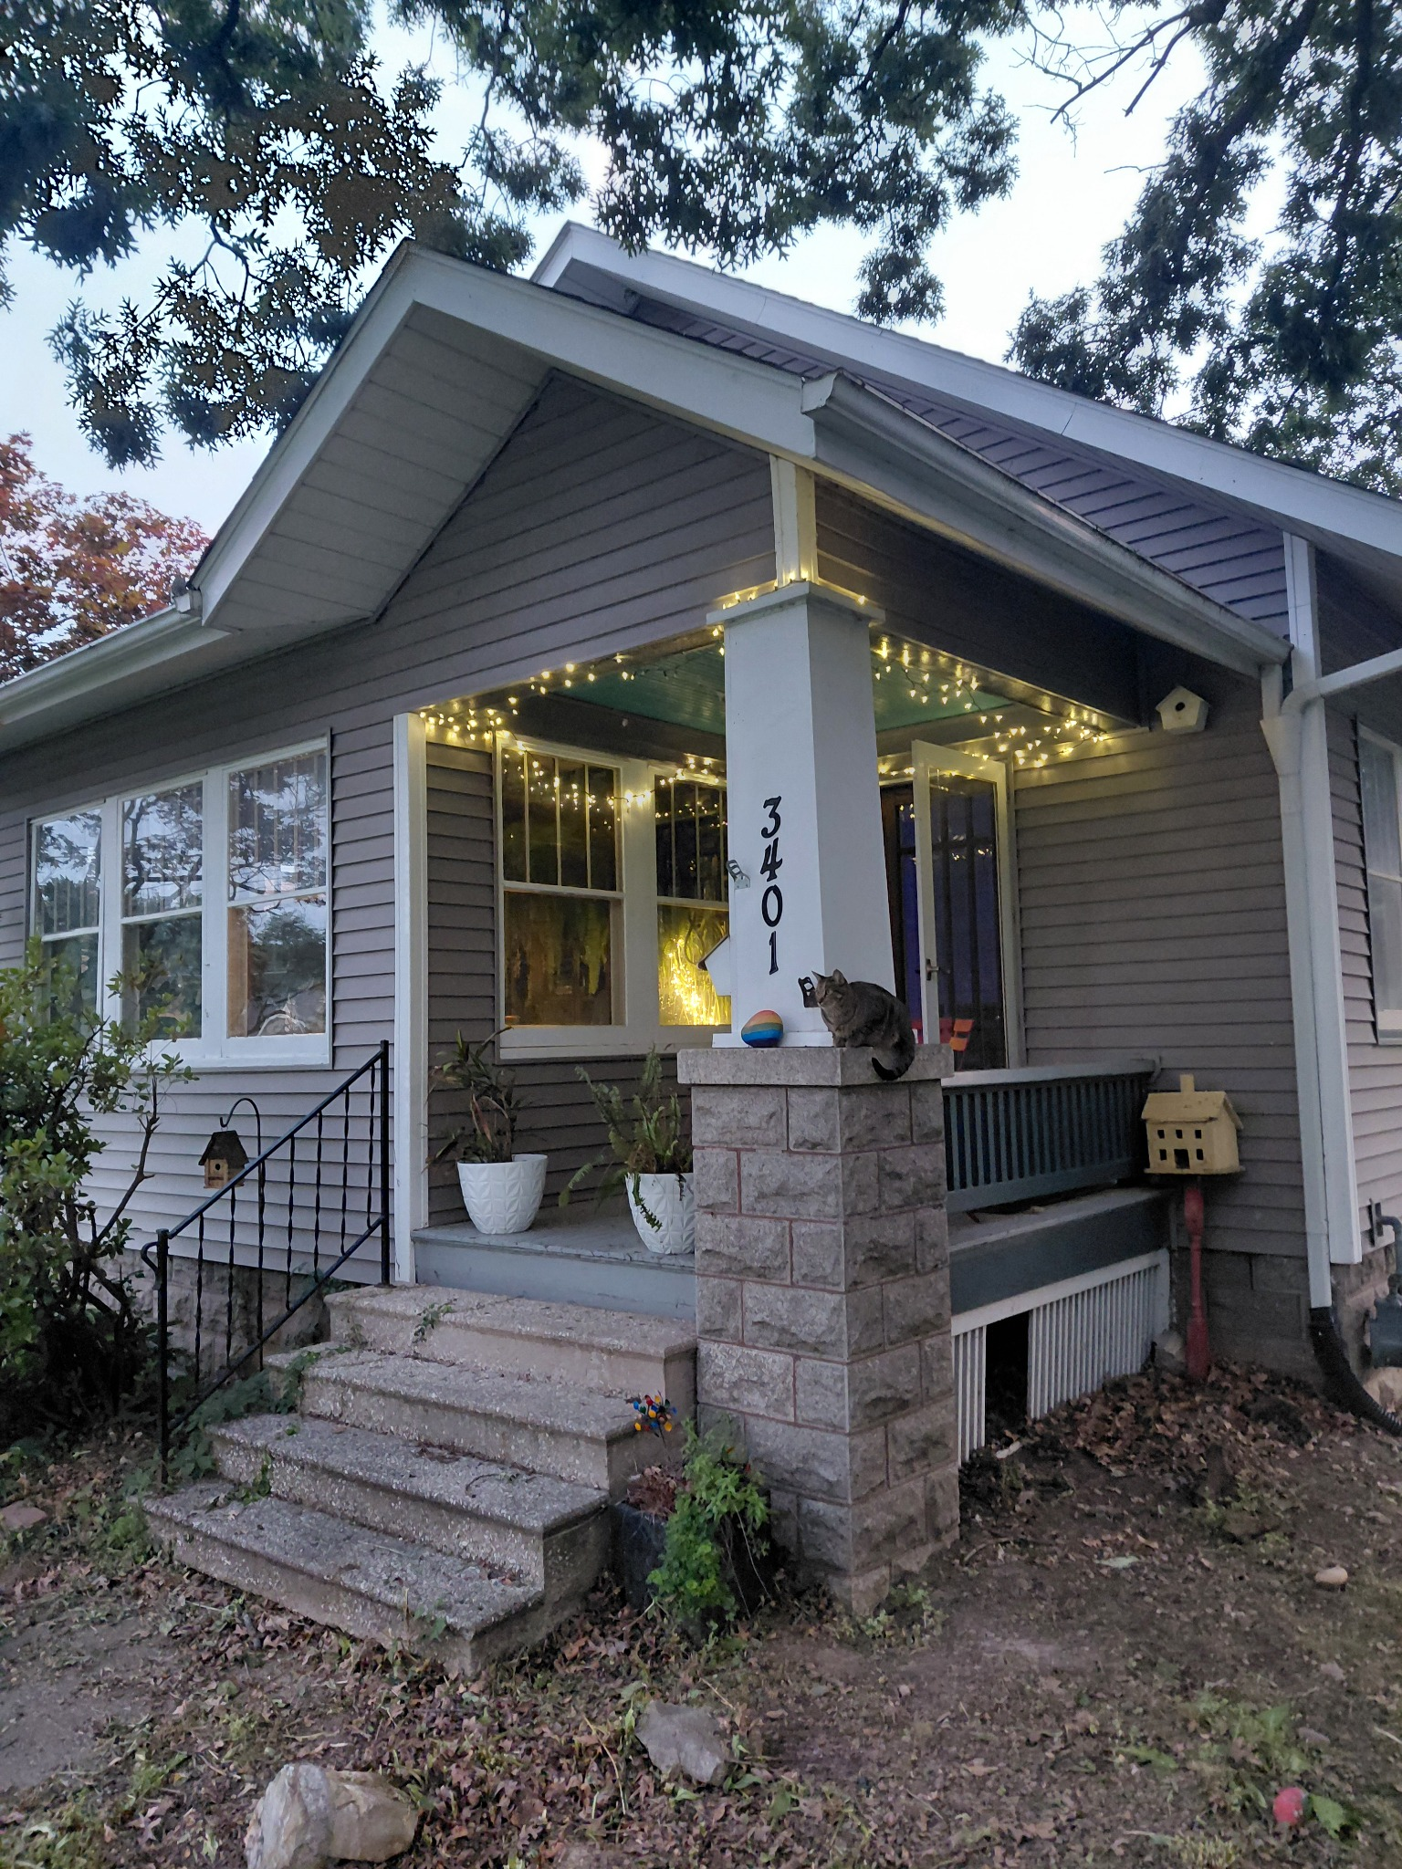
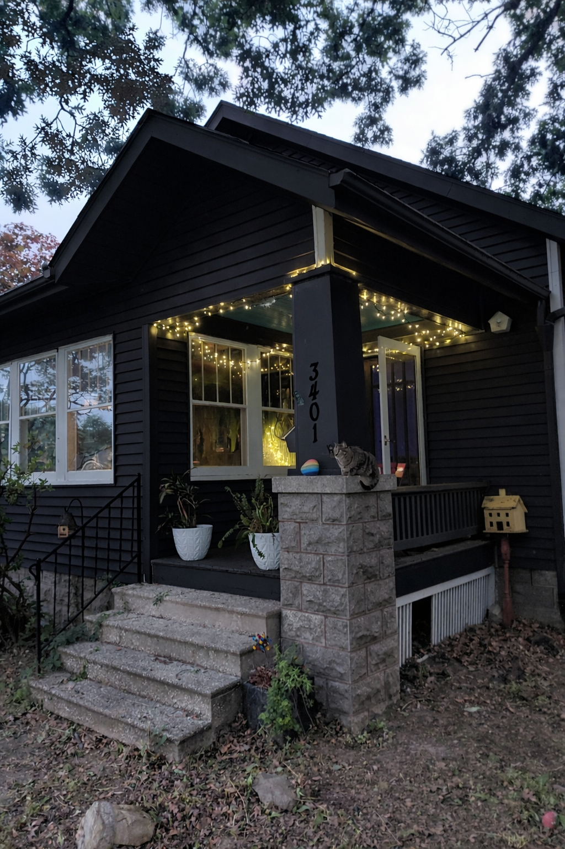
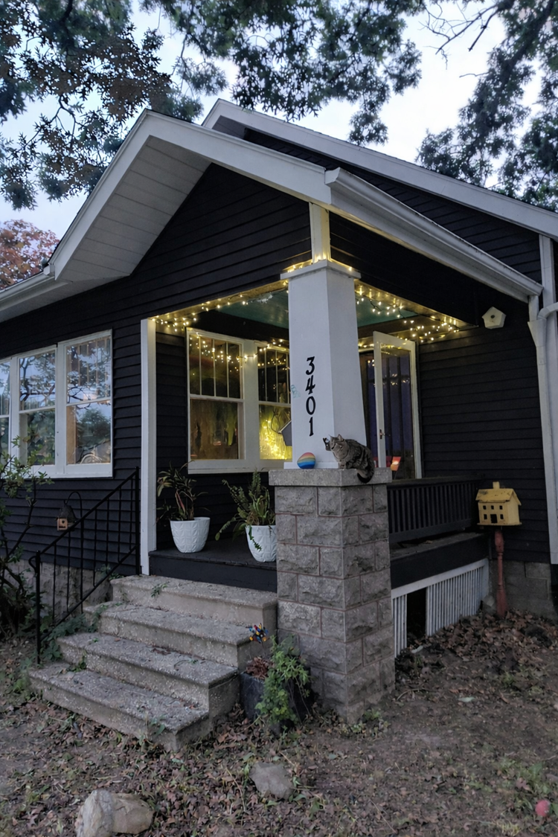
House siding
Round 1
Round 2
Original

Slide 17
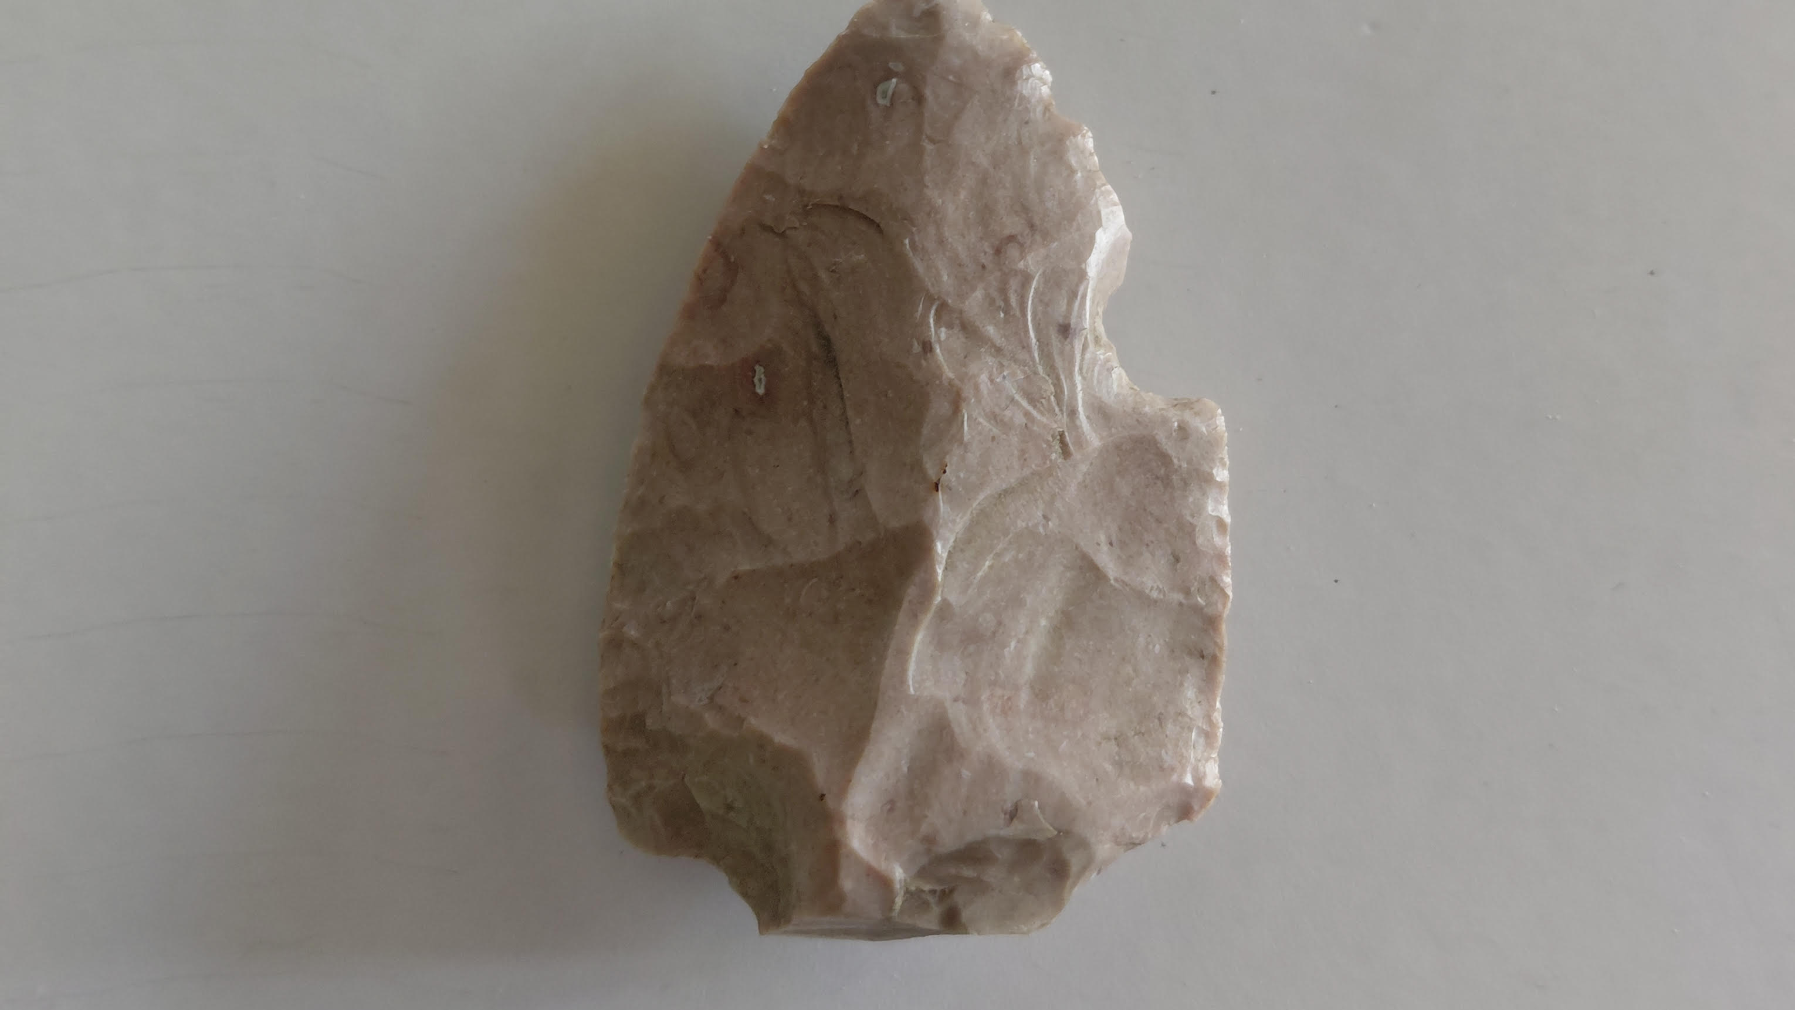
AI Uses
A legitimate piece of human history
Chipped edges → It’s been intentionally shaped (called “flintknapping”)
Material → Looks like chert, which was very commonly used in Illinois for tools
Break pattern → The tip or base is missing, which is super common—many points
break during use or manufacturing
Thickness → A bit thick, which could mean
:Early-stage tool (not fully finished), OR
:A larger spear/dart point rather than a small arrowhead
Archaic period: ~8,000–1,000 BC
Woodland period: ~1,000 BC – 1000 AD
Mississippian: up to ~1500 AD

Slide 18
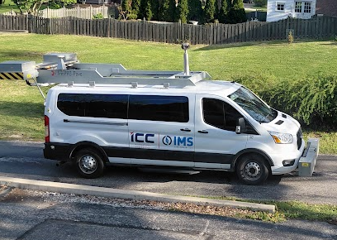
AI Uses
What in the world is this?
That’s a road/underground utility scanning vehicle—most likely doing infrastructure testing.
Ground Penetrating Radar (GPR)
Usually means one of these:
-Upcoming road work or resurfacing
-Utility upgrades (water/sewer/gas)

Slide 19

Tricks to Writing a “Prompt”
Explain it to me like I’m a child
Act like a…
What should I watch out for?
Ask me a few questions so you can give me a better answer
What else do you need to know before answering?
Tell me pros and cons
Tell me ways I could be wrong

Slide 20
Why Know AI?
Scam prevention
My daughter is 17…
Inspiring
Expanding knowledge
Making your life easier
Notes:
Inspiring. Recipes.
17 – graphic designer, grocery store, physical theopist,

